Slide 1
Fixed Assets

Slide 2
What is a Fixed Asset?
*An asset, as defined by the PASSHE Board of Governors, is equipment, furniture, buildings and improvements with a cost in excess of $5,000 and an estimated useful life of two years or more.
*All costs associated with placing an asset in service, including freight, installation costs, site preparation costs, alterations, and professional fees are included in the capitalized value.
*Also, if university employees, such as engineers, carpenters and electricians, contribute to the completion of a capital project, the associated salaries, wages, benefits, and other costs are included in the capitalized value.

Slide 3
Example 1: Single PO #
Piece of equipment: $3,500.00
Software: $300.00
Training: $1000.00
Shipping: $200.00
Total Cost: $5000.00
Fixed Asset? YES

Slide 4
Example 2: Multiple PO #’s
Piece of equipment: $3,500.00
Software: $300.00
Shipping: $200.00
Total Cost: $4000.00
Fixed Asset? NO

Slide 5
Example 2: Multiple PO #’s
Piece of equipment: $3,500.00
Software: $300.00
Shipping: $200.00
Total Cost: $4000.00
Training (Separate PO#) $1000.00
Fixed Asset? NO

Slide 6
Example 3: Gifts
The president receives a painting of North Hall by a former student as a gift for his home.
Appraised Value: $5000.00
Fixed Asset? YES

Slide 7
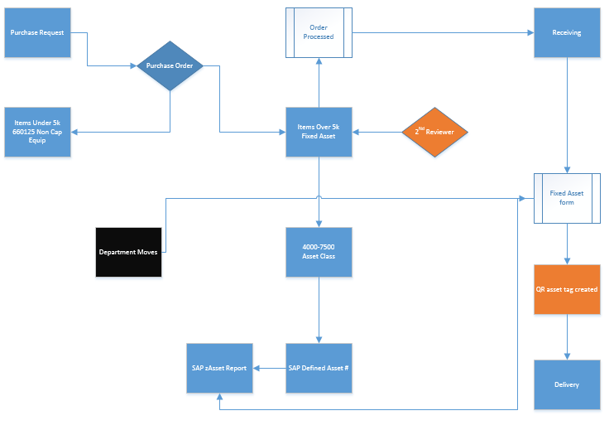
“Road Map”

Slide 8
Online Fixed Asset Form
https://portal.my.mansfield.edu/sites/employees/Fixed%20Asset%20Form/Forms/AllItems.aspx

Slide 9
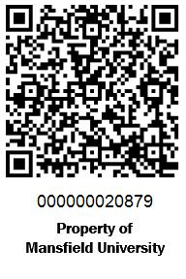
QR Code (Quick Response Code)

Slide 10
Next Steps
All departments will be emailed a Fixed Asset Listing report in February 2014. Must be completed and returned by March 31st 2014 to Controllers Office.
Cleanup of Fixed Assets in SAP by April 2014.
Complete Fixed Asset audit and tagging to be completed by Summer 2014.
New University Fixed Asset Responsibility Policy adopted.

Slide 11
Ongoing Campus Inventory
Half Inventory will be performed every year.
Listings will be sent to Chairs\Directors of Departments for verification.
Spot Checking will be performed by Fixed Asset manager for verification.

